Slide 1
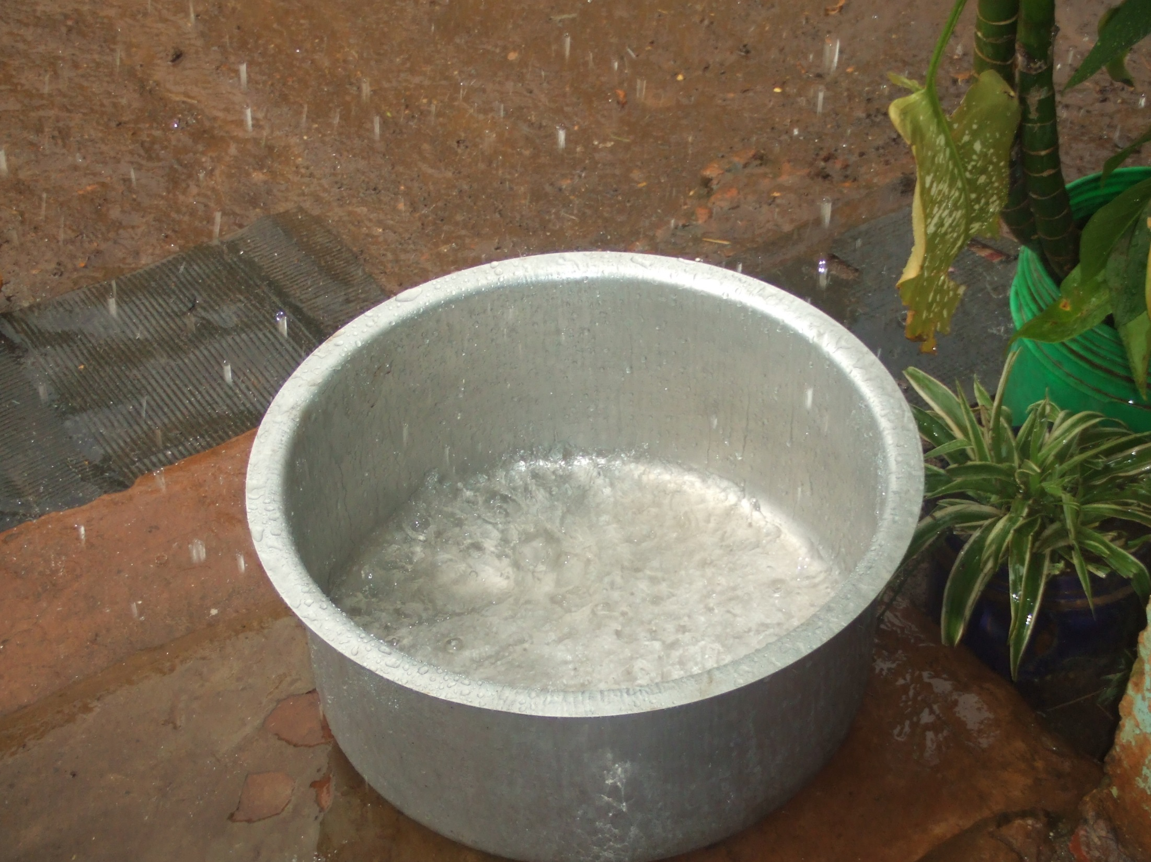
A precious commodity

Slide 2
Tuishime School

Slide 3
320 children to look after each day

Slide 4
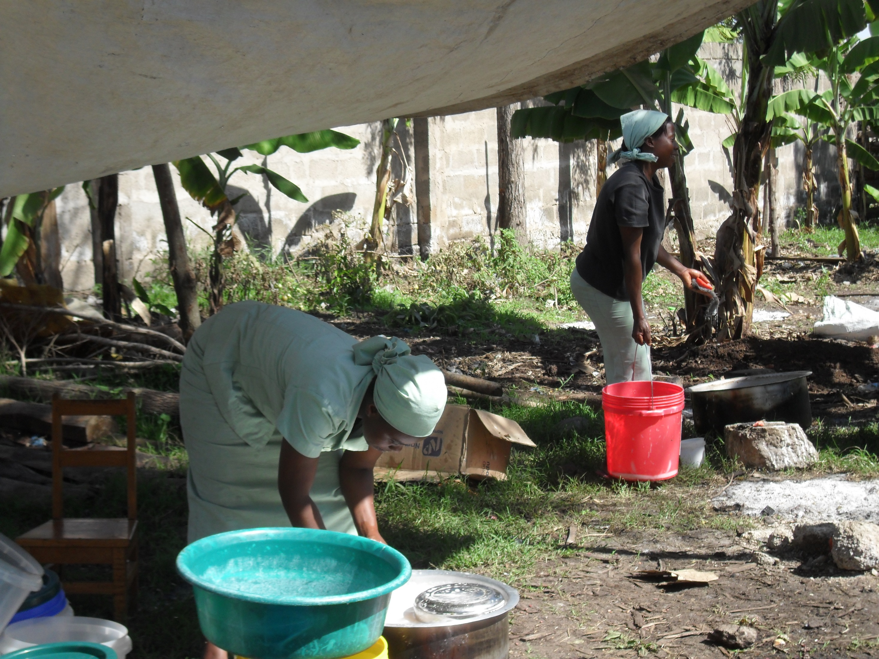
Cooking and washing up

Slide 5
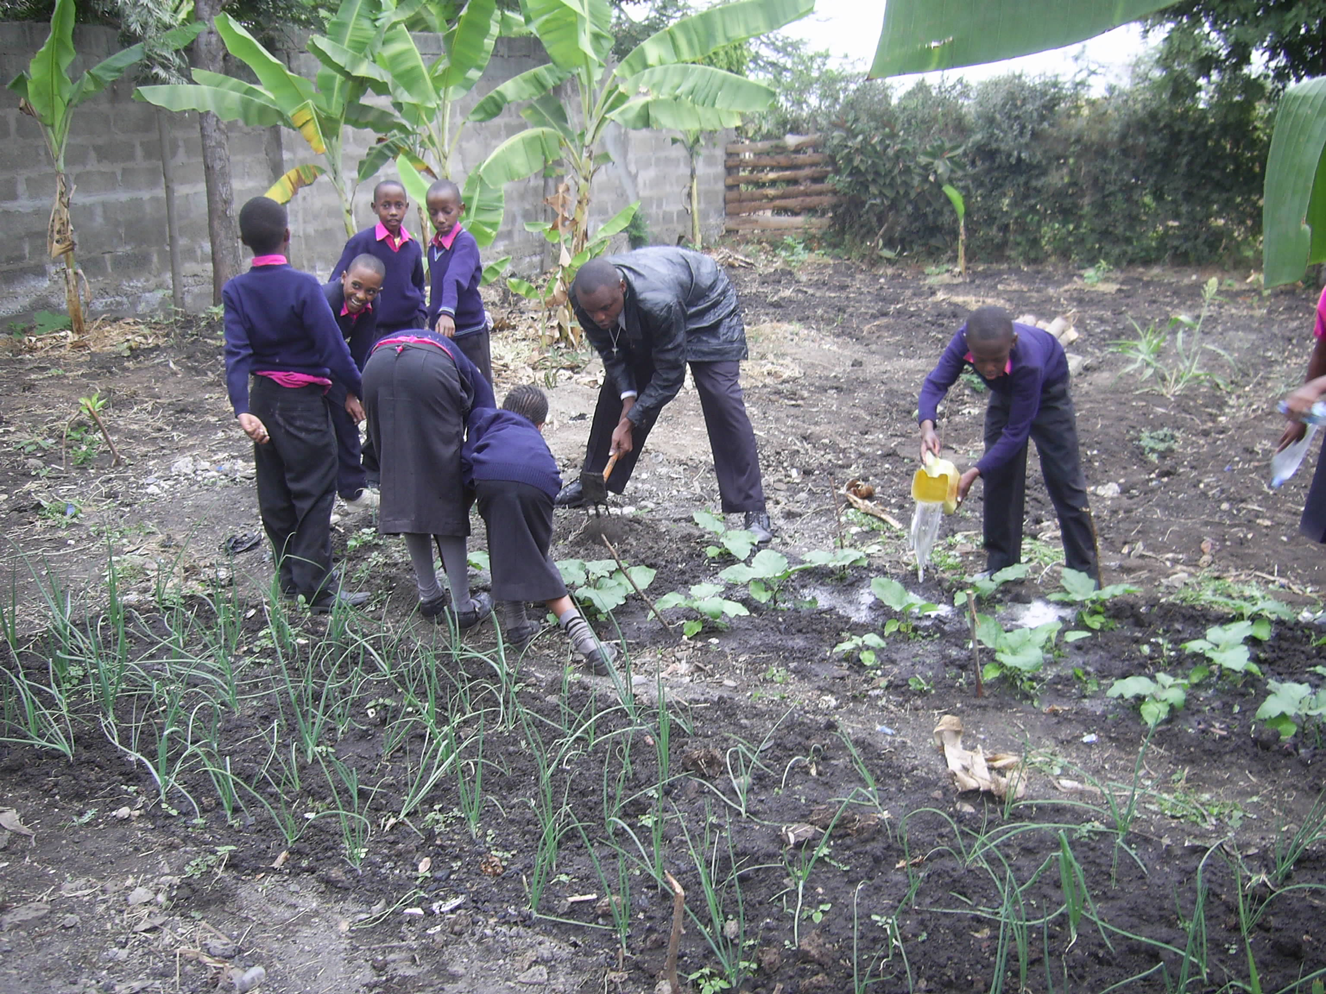
Teaching children how to grow plants

Slide 6
But it all needs …

Slide 7
Water

Slide 8
But no water

Slide 9
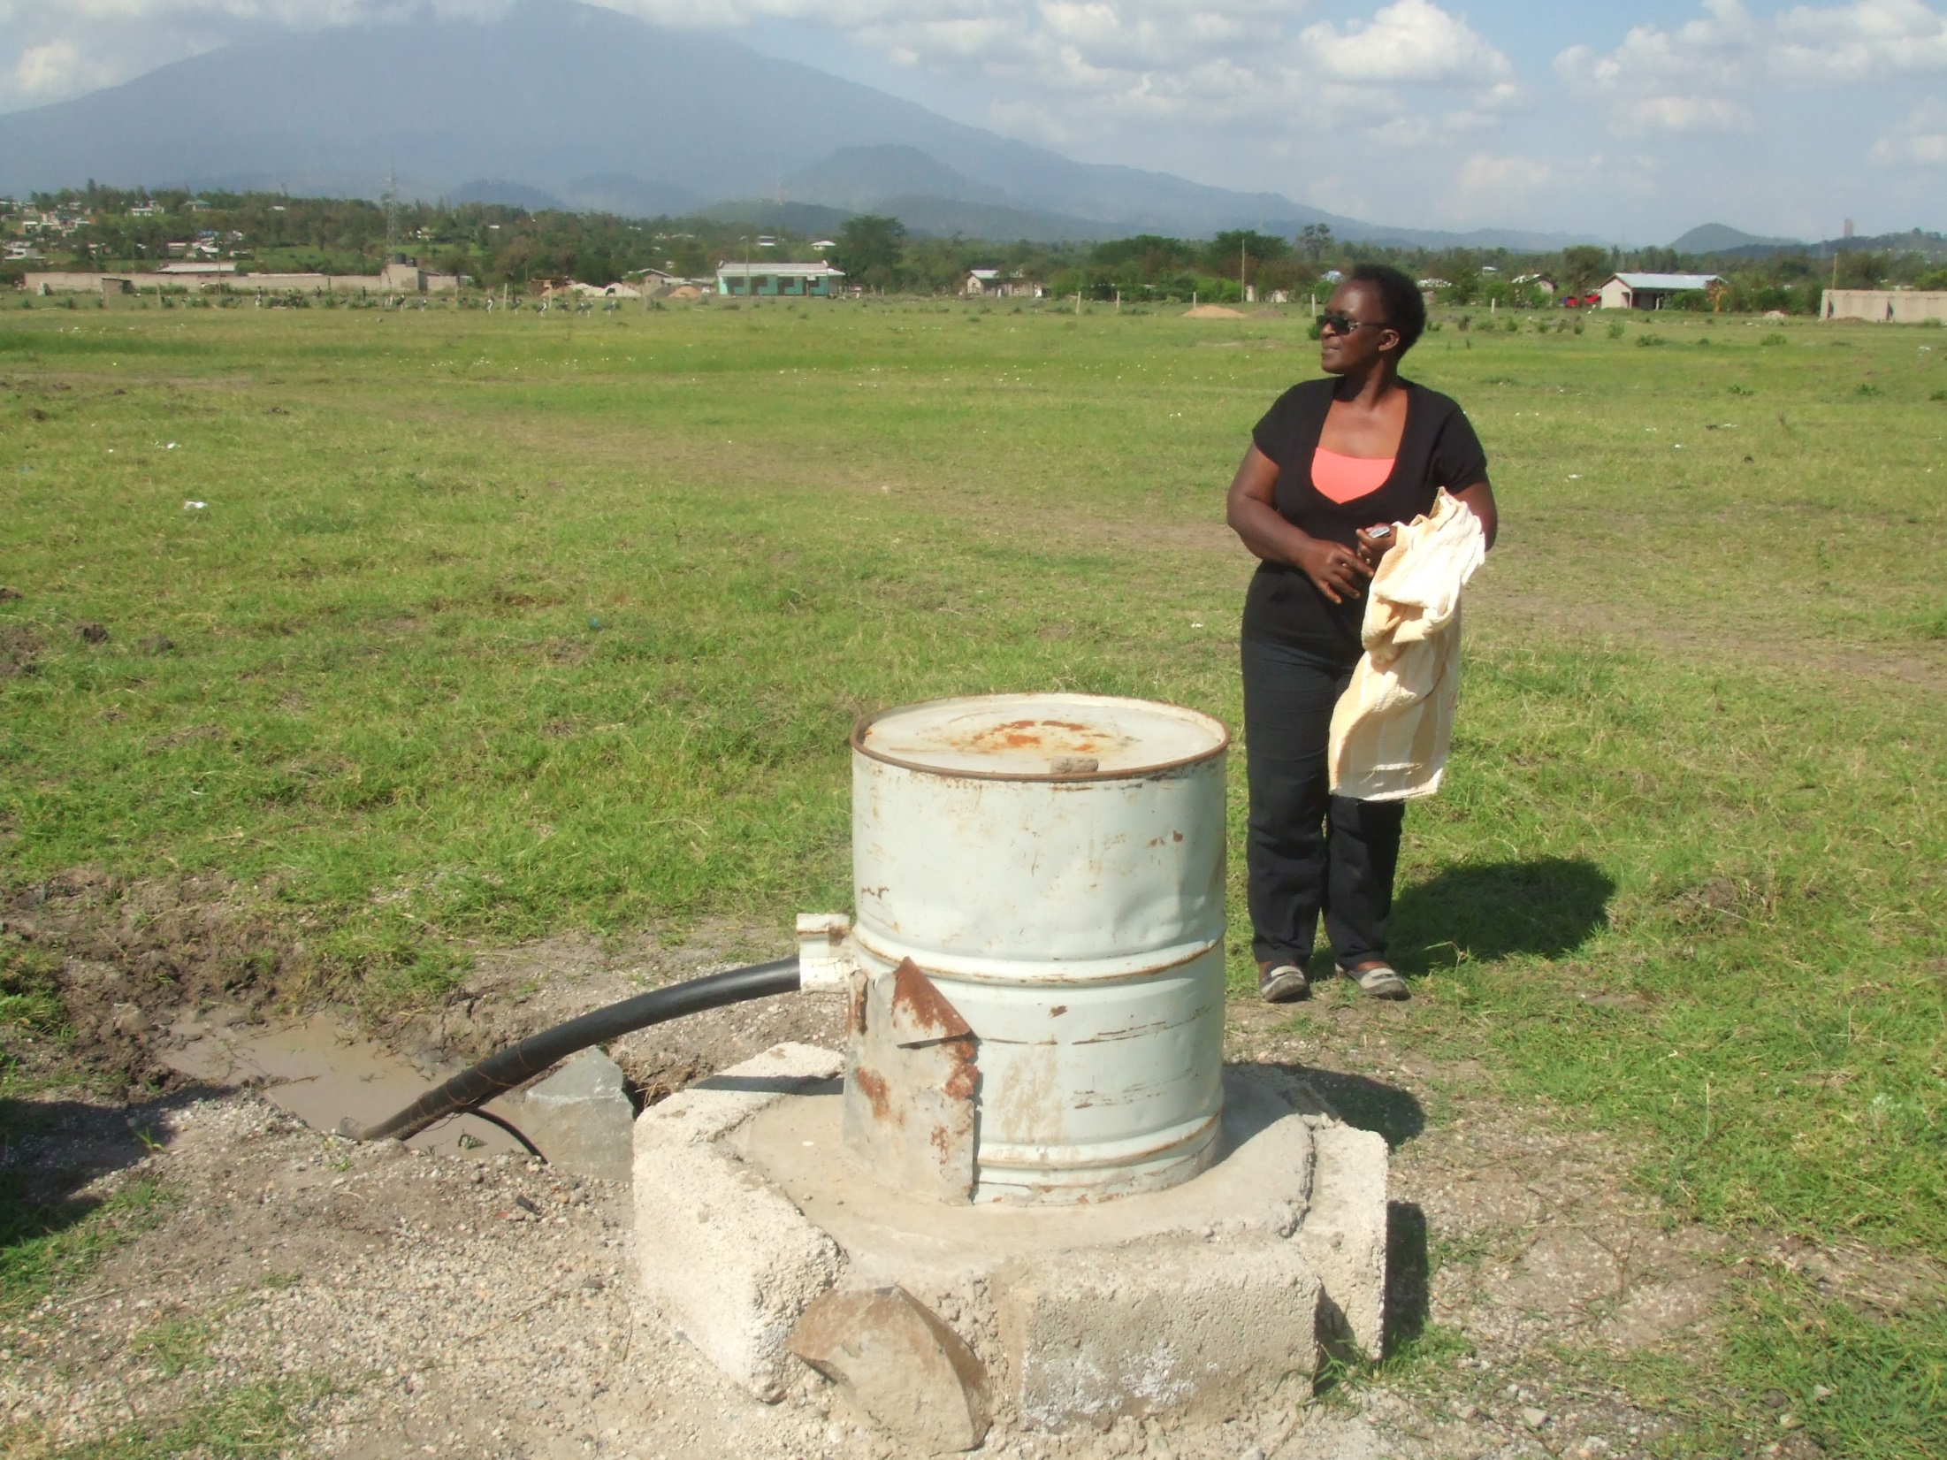
A borehole is the answer ….

Slide 10
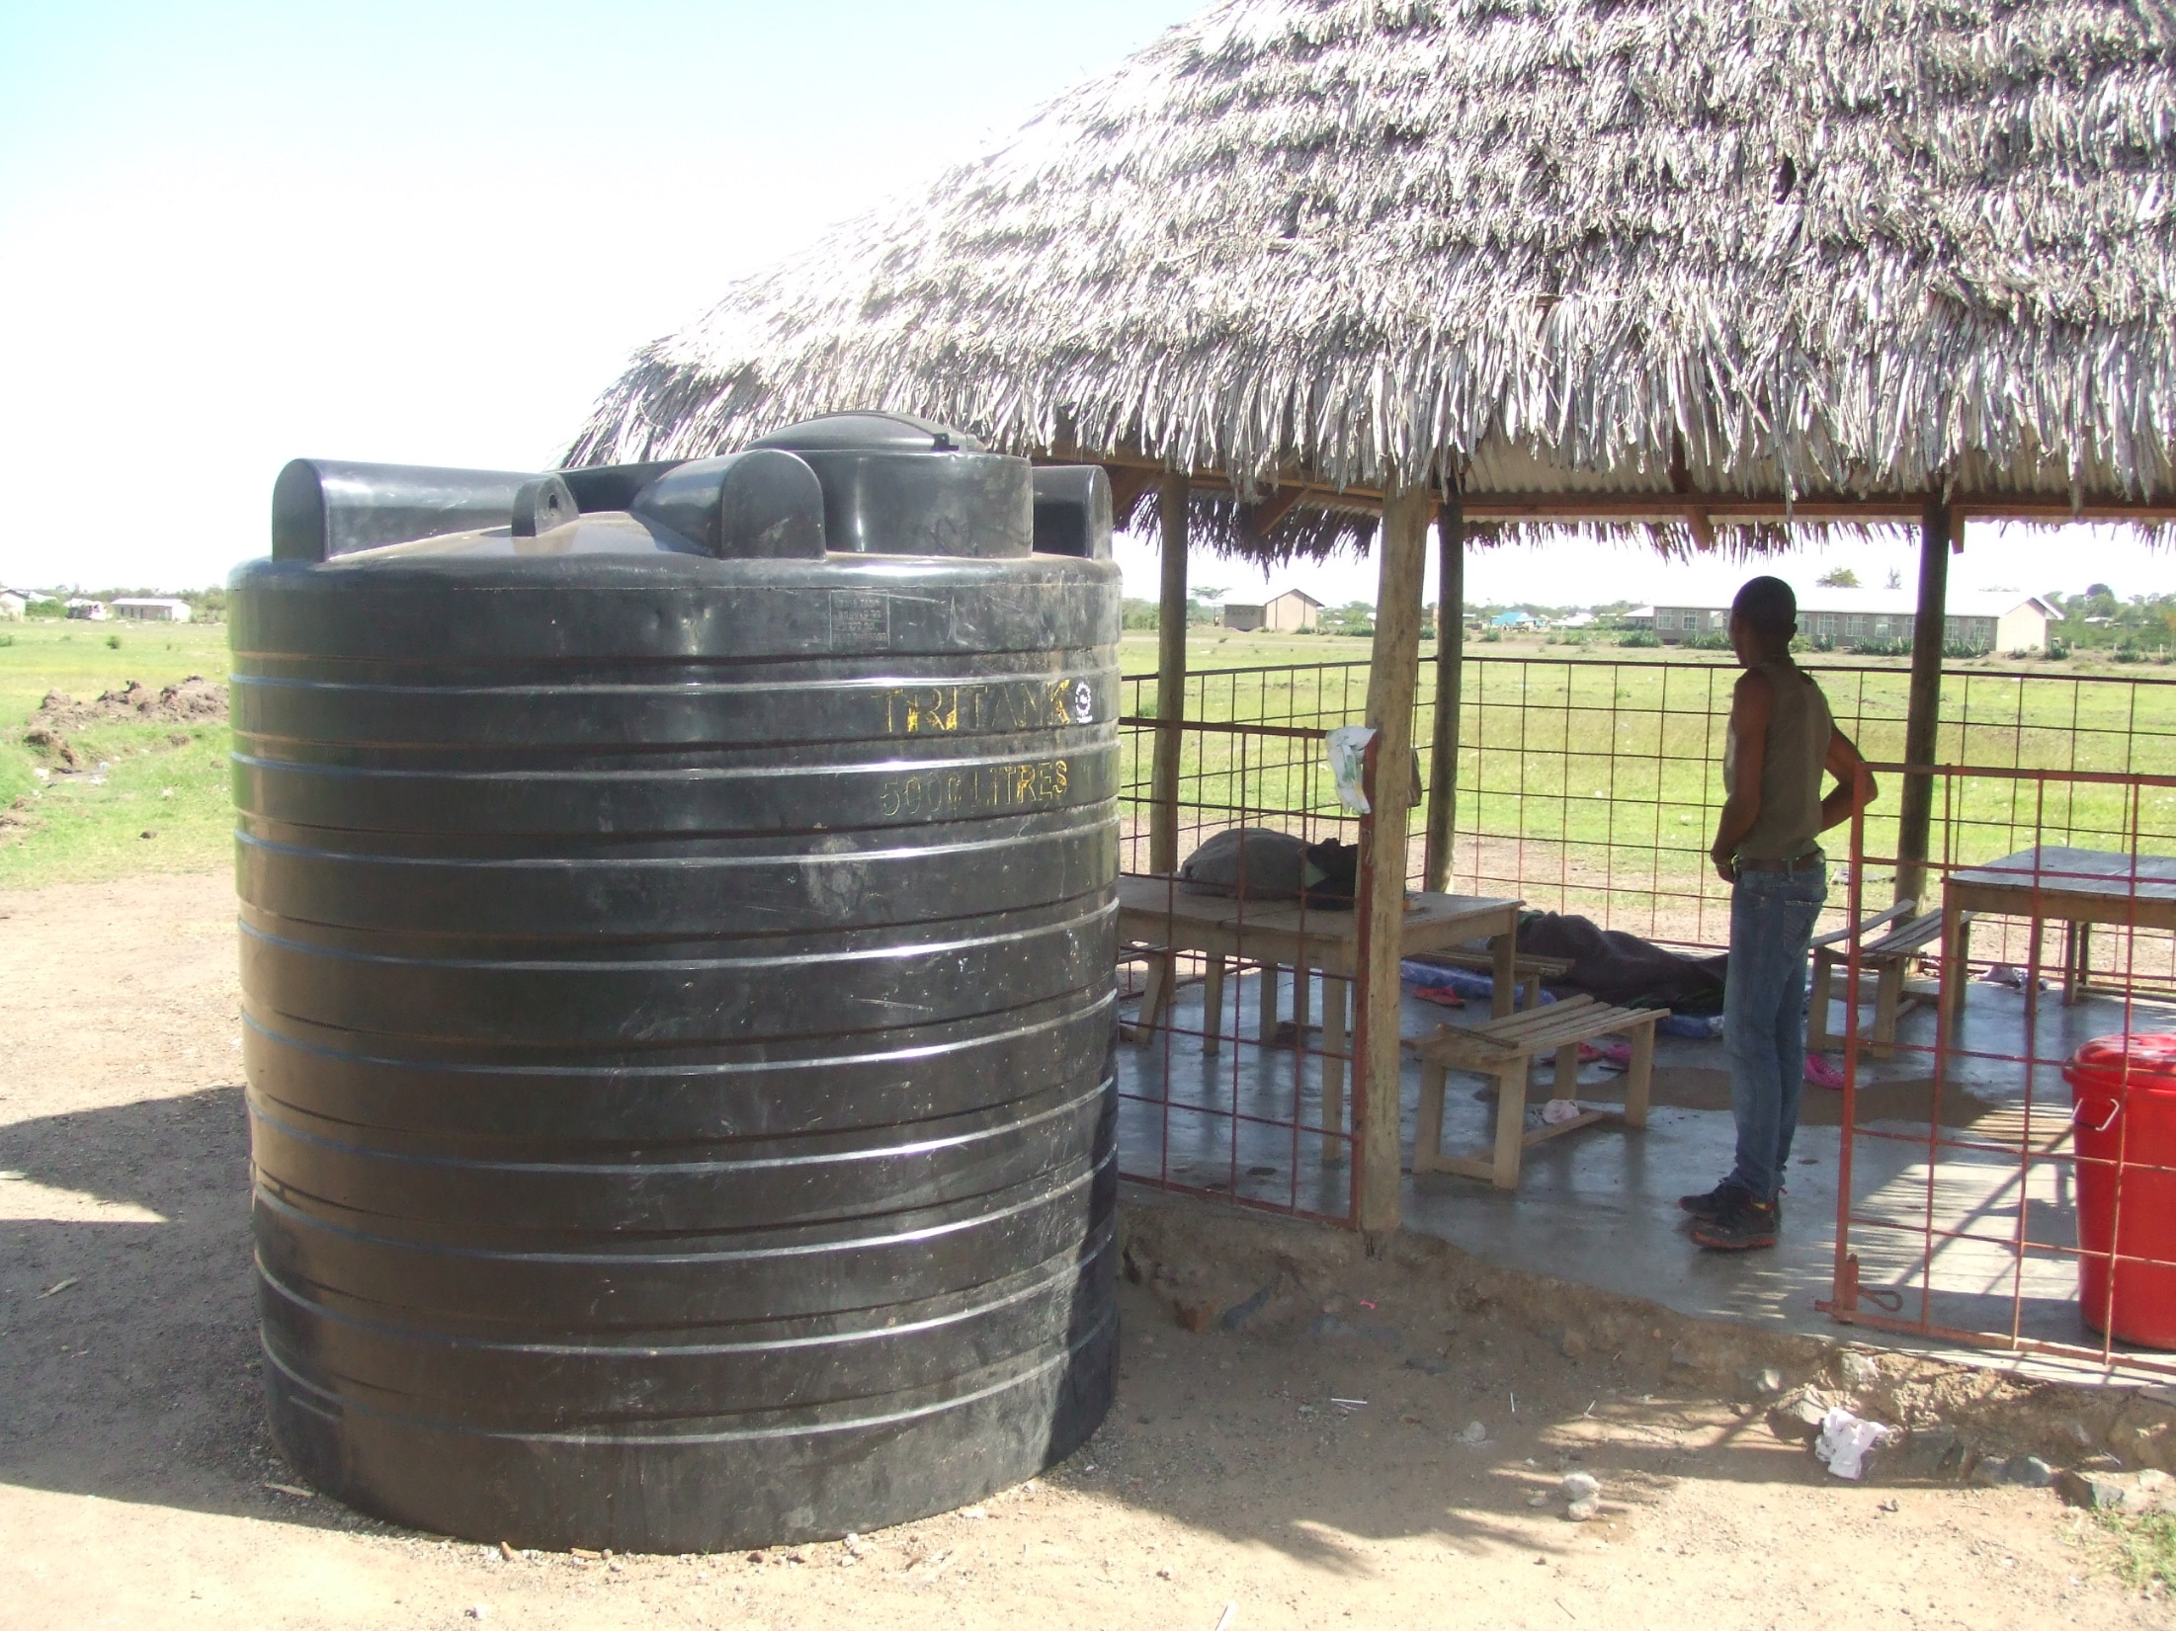
with large storage tanks

Slide 11
Our next project

Slide 12
Water

Slide 13
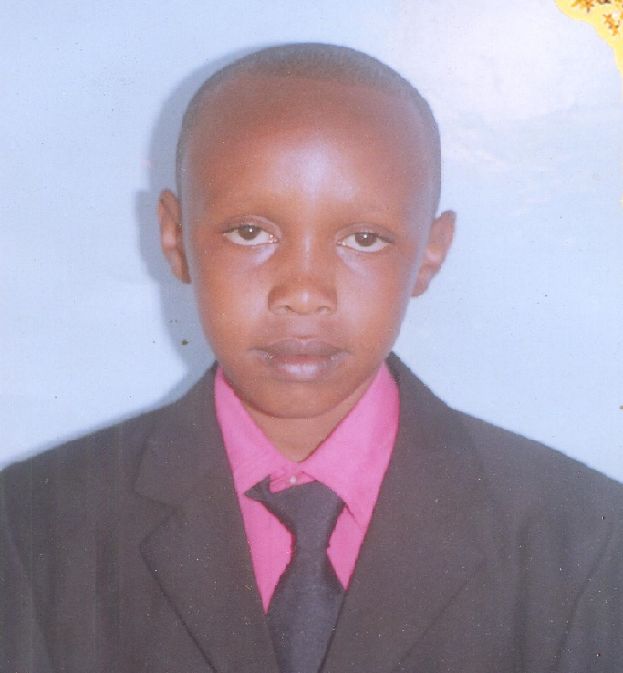
Sponsored student -
Thomas
Godfrey

Slide 14
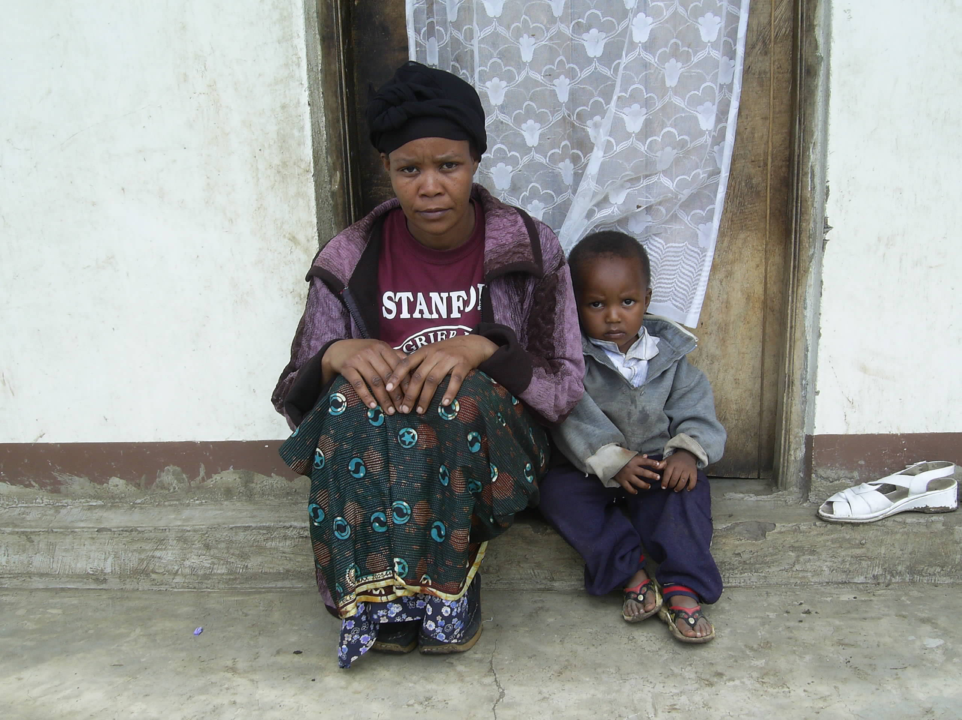
Aunt Nooru – Thomas’s guardian

Slide 15
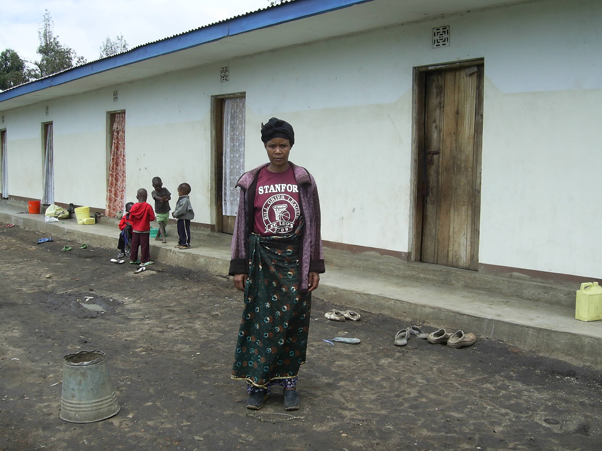
The house where Thomas stayed with his Aunt

Slide 16
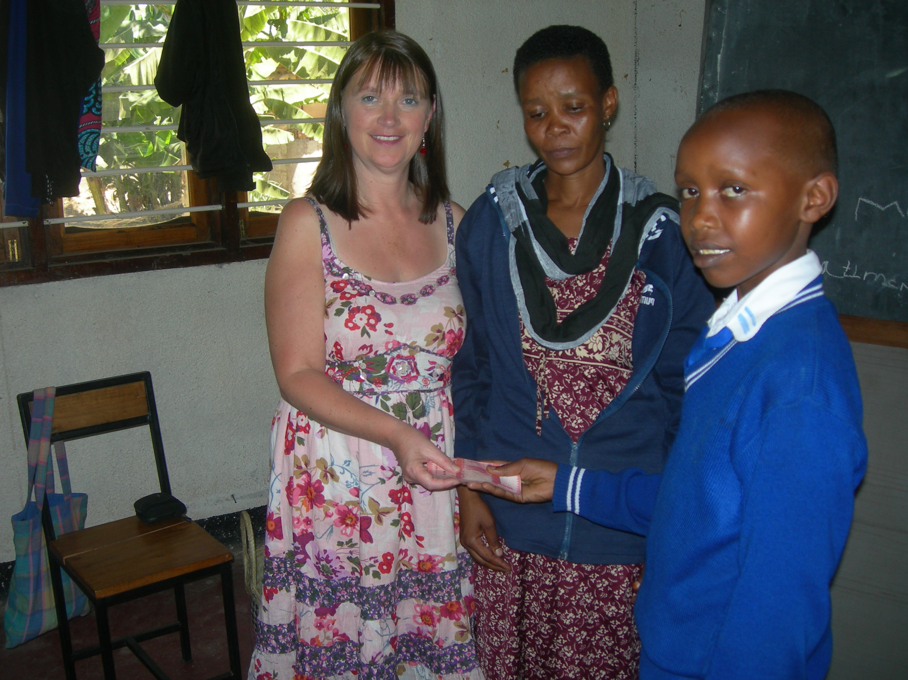
Maggie passing on a donation to Thomas from his sponsor

